Slide 1
ASYNCIO

Slide 2

asyncio
When you are using desktop application , suddenly if it freezes ! May be app performing lengthy operation using UI thread which blocks UI.
Asynchrony : (Awaitable Pattern)
To provide a responsive, potentially lengthy operations should be done asynchronously, on a separate thread which is now available in python (async and await).
What is it? Not about :
- IO bound workload - CPU bound workload
- scalability and throughput - Threads
- Responsiveness - Parallel workload

Slide 3
ASINCIO
Concurrency is like having two threads running on a single core CPU.
Instructions from each thread could be interleaved, but at any given time,
only one of the two threads is actively making progress.
Parallelism is like having two threads running simultaneously on different cores of a multi-core CPU.

Slide 4
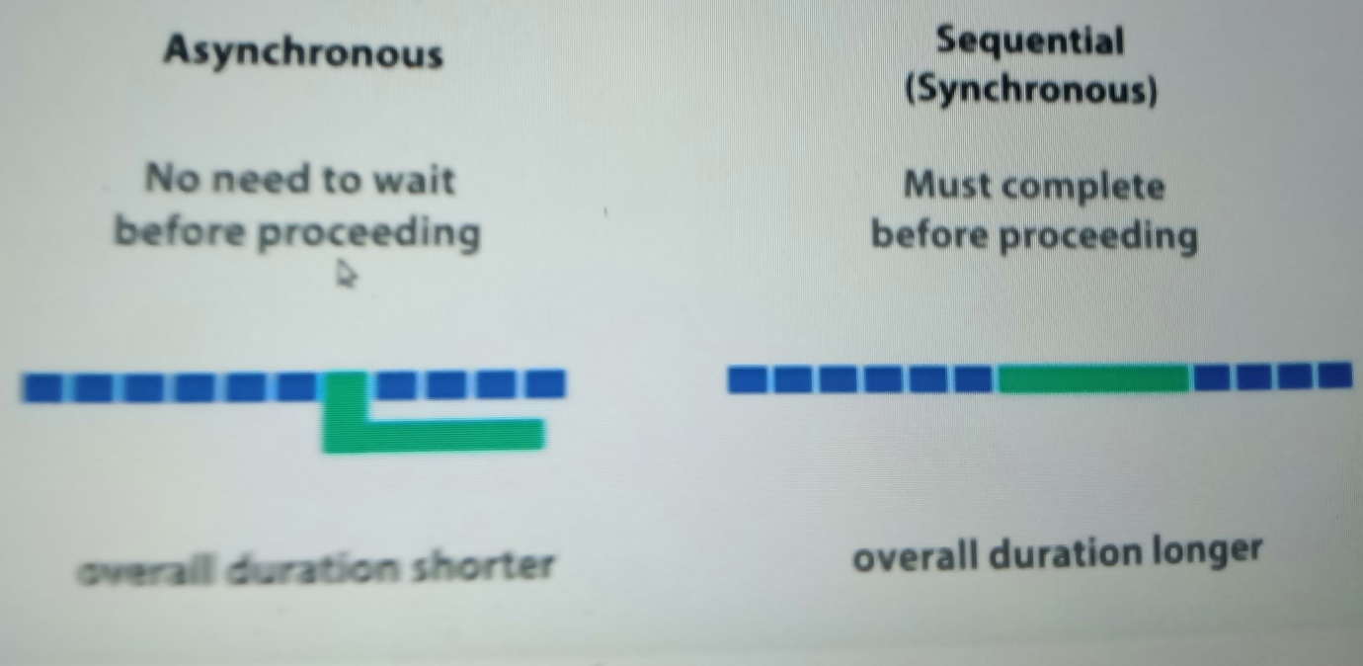
ASINCIO

Slide 5
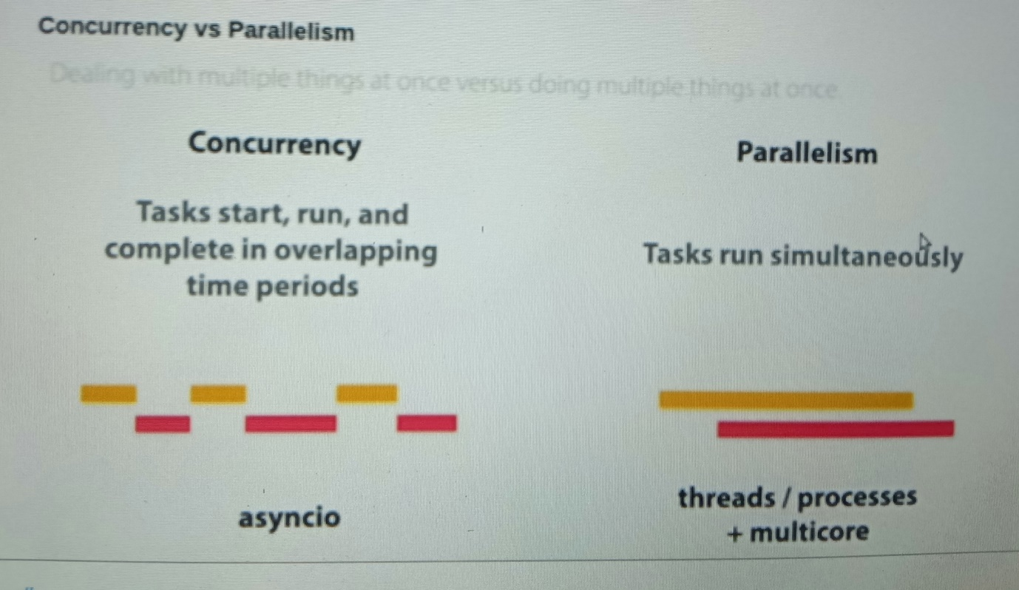
ASINCIO

Slide 6
ASINCIO
Asynchronous programming?
Improves performance & utilization of machine resources effectively.
The Event Loop
The event loop is the orchestrator of the symphony.
It runs tasks one after the other.
At any given time, only one of the tasks is running.
The event loop time is precious.
If you are not making progress, you should step off the loop, so that someone else can.
Event loop is the measure of progress.

Slide 7
ASINCIO
Synchronous:
- Runs functions one after another
Asynchronous: asyncio
runs multiple functions in parallel without threads.
functions that regularly suspended by awaiting something should not use blocking functions like time.sleep()
Fire off some task, and decide that while we don’t have the result of that task means do someother work instead of waiting.

Slide 8
Asyncio
User Mode Process vs Kernel Mode Process
Synchronous Programming
Blocked
User Mode
IO Kernel Mode
Asynchronous Programming
User Mode
IO Kernel Mode

Slide 9
Asyncio
Synchronous vs. asynchronous
data = DownloadData(...);
ProcessData(data);
UI Thread
STOP
DownloadData
ProcessData
future = DownloadDataAsync(...);
future.ContinueWith(data => ProcessData(data));
DownloadDataAsync
ProcessData

Slide 10
ASINCIO
The Coroutine & Task
Coroutines are a key element of the symphony which are basically functions.
It is the coroutines, and their co-operative nature, that enables giving up.
Asyncio : Asyncio is all about writing asynchronous programs in Python.
Asyncio is a beautiful symphony between an Event loop, Tasks and Coroutines all coming together so perfectly .

